Slide 1
Gentech Case Study
Team : 350

Slide 2
The Team 350
1st
2nd
3rd
4th
Michelle Yu
Rahat Kapoor
Sandeep Chintu
Sudeshna Banerjee

Slide 3
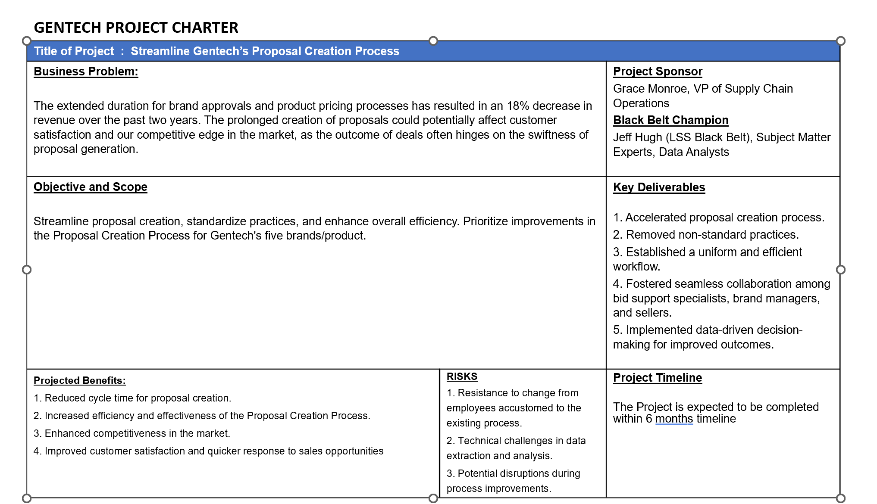

Slide 4
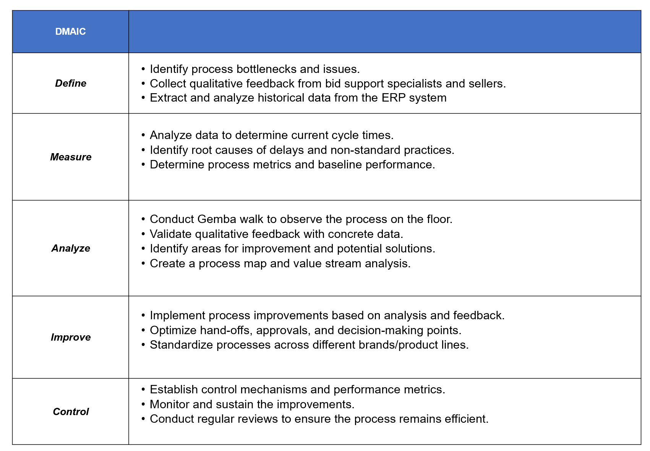

Slide 5
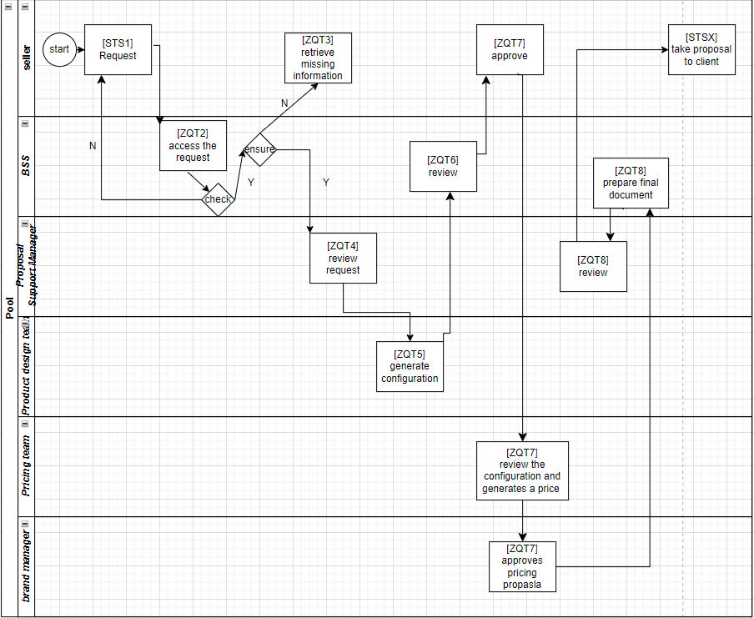
2. Process Map

Slide 6
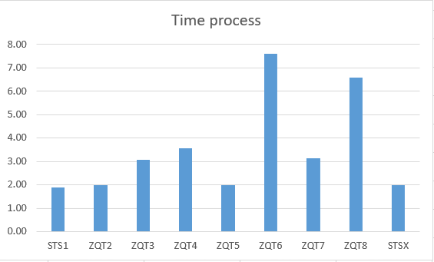
3. Average time is highest for ZQT6

Slide 7
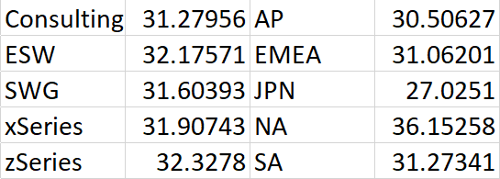
- End-to-end cycle time: 31.86 - Japan is the best performer among all regions; NA is the worst performer. - zSeries brands take the longest average time to complete the process. - Consulting brand took the least amount of time on average. - Processes are consistent across all brands and regions, with only minor variations in efficiency.

Slide 8
4. Defects per million opportunities (DPMO)
Proposal taking longer than 55 minutes is called a defect.
Sample Size: 250,000
Delayed Proposal : 5,418
DPMO : 21672 or 2.17%
CHALLENGE
Despite being red, Mars is actually a very cold place
We are only at 2 sigma level

Slide 9
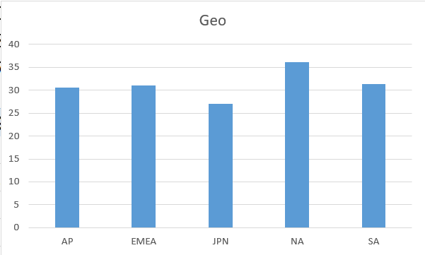
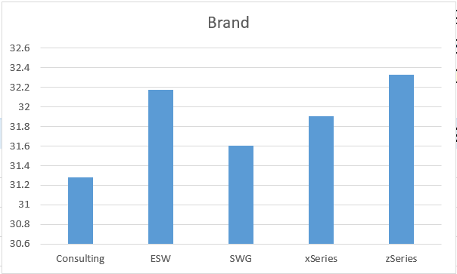
5. Brands and Geographies Performance

Slide 10
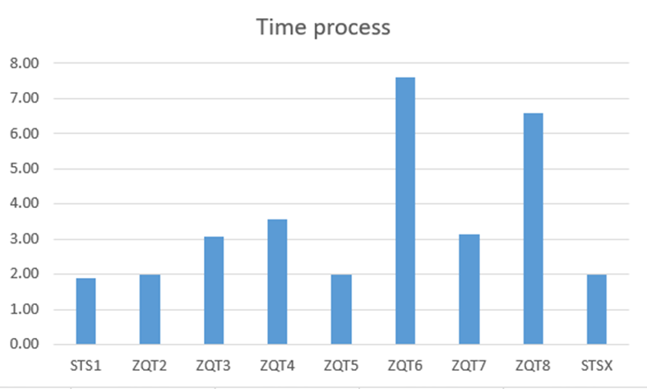
6. Analyzing Timestamp Data

Slide 11
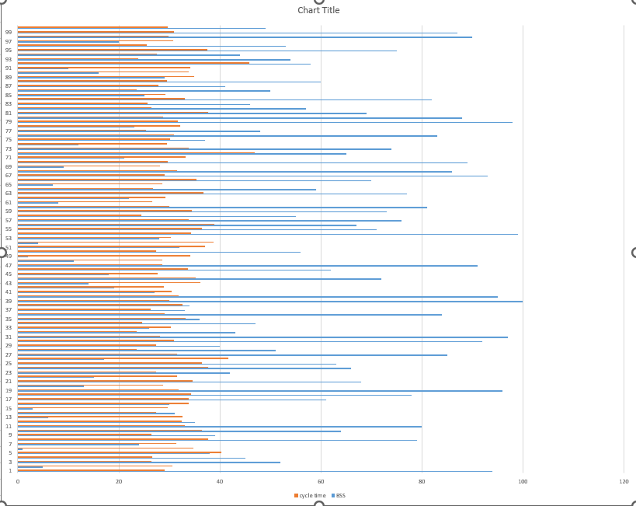
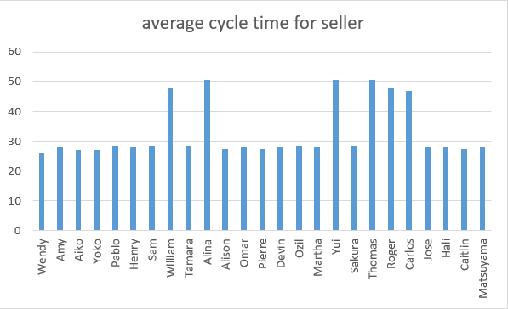
7. Seller and BSS Performance
FIRST STEP
Mercury is the closest planet to the Sun and the smallest in the Solar System
HALLENGE
Despite being re, Mars is a cold place full of iron oxide dust
SOLUTIONS
BSS 51 is able to complete the process in an average of 23.5 days. On the other hand, BSS 65 is able to complete the process in an average of 46.9 days. Overall, the bid support staff do not perform the same as their counterparts.
NEXT STEPS

Slide 12
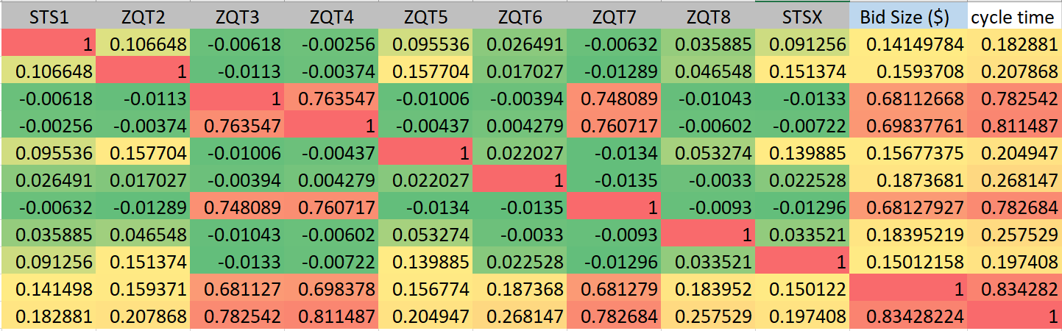
8. Correlation
The data indicates a significant positive correlation between the size of a bid and the overall time it takes to complete the cycle, with a correlation coefficient of approximately 0.83. This suggests that larger bids tend to be associated with longer cycle times, implying that as the magnitude of the bid grows, the duration required to process and complete the cycle correspondingly extends

Slide 13
Potential Issues
Enhanced Communication and Identification
Implement a systematic and standardized approach to identify BSS agents promptly. Ensure that Sellers and other stakeholders can easily determine the responsible BSS for a given proposal
Role Clarity
Clearly define the roles and responsibilities of BSS agents, ensuring that Sellers and other team members understand their functions and expertise areas
Training and Support
Offer training and support for BSS agents to improve their visibility and effectiveness in the process, reducing Sellers' reliance on handholding.
Continuous Monitoring
Implement a system for monitoring and measuring the efficiency of BSS agent identification. Regularly review and refine the process to ensure it remains effective
Recommendation
Work towards enhancing the efficiency of the proposal creation process and reducing cycle time, which will ultimately contribute to the organization's competitiveness in the market

Slide 14
Case Study Infographics
START
METHOD
CLOSURE
Jupiter is the biggest planet in the entire Solar System
Planet Mercury is the closest one to the Sun and the smallest
Planet Venus has a beautiful name and is the second one
2015
2016
2018
2019
2020
DEFIANCE
SETTLING
Despite being red, Mars is a very cold place full of iron oxide dust
Planet Saturn is the ringed one. It’s made of hydrogen and helium

Slide 15
Case Study Infographics
STUDY
Mercury is the closest planet to the Sun and also the smallest one
LAYOUT
It’s actually a very cold place. Mars is full of iron oxide dust
PROCESS
ENDING
Saturn is composed of hydrogen and helium and is the ringed one
ACCORD
Jupiter is a gas giant and the biggest planet in the entire Solar System
SET UP
Venus has a beautiful name and is the second planet from the Sun

Slide 16
Case Study Infographics
Mercury is the closest planet to the Sun and also the smallest planet of them all in the Solar System
OVERVIEW
Mercury is the smallest
Despite being red, Mars is actually a very cold place full of iron oxide dust. It was named after a god
CHALLENGES
Mars is actually very cold
Venus has a beautiful name and is the second planet from the Sun. It has a poisonous atmosphere
SOLUTIONS
Venus is the second
Jupiter is a gas giant and the biggest planet in the Solar System. It was named after a god
RESULTS
Jupiter is a gas giant

Slide 17
Case Study Infographics
BEGINNING
FRAMEWORK
DATA
CONCLUSION
Mercury is the smallest planet in all the Solar System
Saturn is composed mostly of hydrogen and helium
Despite being red, Mars is actually a very cold place
Jupiter is a gas giant and the biggest one of them all

Slide 18
Case Study Infographics
 | PLANNING | KNOWLEDGE | DATA | ENDING
PENDING CASE | Mercury is the smallest planet | Despite being red, Mars is a cold place | It's a gas giant and is the biggest planet | Venus is the second planet from the Sun

Slide 19
Case Study Infographics
SURVEY
ACCORD
Mercury is the closest planet to the Sun
Jupiter is the biggest object in the Solar System
FRAMEWORK
EFFECT
Venus has a beautiful name and is the second planet
Mars is actually a cold place full of iron oxide dust

Slide 20
Case Study Infographics
01
Planning
It’s a gas giant and the biggest planet
04
Criteria
02
It’s the farthest planet from the Sun
Method
Venus is the second planet from the Sun
05
Consequence
03
Mercury is the closest planet to the Sun
Data
Despite being red, Mars is a cold place

Slide 21
Case Study Infographics
CONCLUSION
PLANNING
METHOD
CRITERIA
Mercury is the smallest planet in the entire Solar System
Jupiter is a gas giant and the biggest planet in the Solar System
Planet Saturn is composed of hydrogen and helium

Slide 22
Case Study Infographics
ONSET
Despite being red, planet Mars is actually a very cold place. It is full of iron oxide dust and was named after a god
DARING
Venus has a beautiful name and also is the second planet from the Sun. It has a poisonous atmosphere
ANSWER
Neptune is the farthest planet from the Sun and the fourth-largest by diameter in the Solar System
CONCLUSION
Mercury is the closest planet to the Sun and also the smallest planet in the Solar System. It was named after a Roman deity

Slide 23
Case Study Infographics
OVERVIEW
CHALLENGE
SOLUTION
RESULT
Jupiter is the biggest planet of them all
It is a ringed planet and a gas giant
Despite being red, Mars is a cold place
Neptune is the farthest planet from the Sun

Slide 24
Case Study Infographics
STUDY
PROCESS
Jupiter is a gas giant and also is the biggest planet in all the Solar System
Neptune is the farthest planet from the Sun and also the fourth-largest one
ANSWER
RESULTS
Saturn is the ringed planet, composed mostly of hydrogen and helium
Mercury is the closest planet to the Sun and the smallest one of them all

Slide 25
Case Study Infographics
KNOWLEDGE
SET UP
Venus has a beautiful name and is the second planet from the Sun in the Solar System
It’s the closest planet to the Sun and the smallest one. It was named after a Roman deity
2nd
4th
1st
3rd
5th
START
PROCESS
CONSEQUENCE
Saturn is the ringed one. It’s made mostly of hydrogen and also helium
Despite being red, Mars is a cold place full of iron oxide dust. It was named after a god
Jupiter is the biggest planet in the entire Solar System and also a gas giant

Slide 26
Case Study Infographics
SURVEY | FRAMEWORK | ACCORD | ENDING
Despite being red, Mars is actually a very cold place full of iron oxide dust | Planet Venus has a beautiful name and is the second planet | Earth is the third planet from the Sun and the one where we live on | Neptune is the farthest planet from the Sun and the fourth-largest
Mercury is the smallest planet in the entire Solar System | Jupiter is the biggest planet of all of them in the Solar System | Saturn is the only planet with rings of all of them in the Solar System | Pluto is now considered a dwarf planet and not the ninth planet from the Sun

Slide 27
Case Study Infographics
1st
Jupiter is a gas giant and the biggest planet in the Solar System
SURVEY
2nd
Despite being red, Mars is a cold place full of iron oxide dust
FRAMEWORK
3rd
Saturn is composed mostly of hydrogen and also helium
ACCORD
4th
Mercury is the smallest planet in the entire Solar System
DATA

Slide 28
Case Study Infographics
Research
Knowledge
Answer
Solution
Earth is the third planet from the Sun
It’s the farthest planet from the Sun
Despite being red, Mars is a cold place
It’s the closest object to the Sun
Result

Slide 29
Case Study Infographics
MERCURY
It’s the closest to the Sun and the smallest one. It was named after a Roman deity
01
JUPITER
VENUS
Jupiter is the biggest planet in the Solar System and also a gas giant
03
02
Venus has a beautiful name and is the second planet from the Sun
MARS
04
Mars is actually a very cold place full of iron oxide dust. It was named after a god

Slide 30
Case Study Infographics
1st Step
2nd Step
Overview
Challenge
Earth is the third planet from the Sun
Mercury is the closest planet to the Sun
Closure
4th Step
3rd Step
Set Up
Answer
Saturn is composed of hydrogen and helium
Jupiter is a gas giant and the biggest planet

Slide 31
Case Study Infographics
OVERVIEW
CHALLENGE
Despite being red, Mars is actually a very cold place
Jupiter is the biggest object in the Solar System
SOLUTION
CONCLUSION
Venus has a very beautiful name and is the second
Saturn is a gas giant and has several rings

Slide 32
Case Study Infographics
BEGINNING
DARE
DATA
EFFECTS
Mercury is the closest planet to the Sun and the smallest
Despite being red, Mars is actually a cold place
Jupiter is the biggest planet in the Solar System
Neptune is the eighth planet from the Sun

Slide 33
Case Study Infographics
RESEARCH
METHOD
CRITERIA
ENDING
Mercury is the smallest planet of them all
Despite being red, Mars is actually a cold place
Jupiter is a gas giant and the biggest one
Neptune is the eighth and farthest-known one

Slide 34
Instructions for use (free users)
In order to use this template, you must credit Slidesgo by keeping the Thanks slide.
You are allowed to:
Modify this template.
Use it for both personal and commercial purposes.
You are not allowed to:
Sublicense, sell or rent any of Slidesgo Content (or a modified version of Slidesgo Content).
Distribute this Slidesgo Template (or a modified version of this Slidesgo Template) or include it in a database or in any other product or service that offers downloadable images, icons or presentations that may be subject to distribution or resale.
Use any of the elements that are part of this Slidesgo Template in an isolated and separated way from this Template.
Delete the “Thanks” or “Credits” slide.
Register any of the elements that are part of this template as a trademark or logo, or register it as a work in an intellectual property registry or similar.
For more information about editing slides, please read our FAQs or visit Slidesgo School:
https://slidesgo.com/faqs and https://slidesgo.com/slidesgo-school

Slide 35
Instructions for use (premium users)
In order to use this template, you must be a Premium user on Slidesgo.
You are allowed to:
Modify this template.
Use it for both personal and commercial purposes.
Hide or delete the “Thanks” slide and the mention to Slidesgo in the credits.
Share this template in an editable format with people who are not part of your team.
You are not allowed to:
Sublicense, sell or rent this Slidesgo Template (or a modified version of this Slidesgo Template).
Distribute this Slidesgo Template (or a modified version of this Slidesgo Template) or include it in a database or in any other product or service that offers downloadable images, icons or presentations that may be subject to distribution or resale.
Use any of the elements that are part of this Slidesgo Template in an isolated and separated way from this Template.
Register any of the elements that are part of this template as a trademark or logo, or register it as a work in an intellectual property registry or similar.
For more information about editing slides, please read our FAQs or visit Slidesgo School:
https://slidesgo.com/faqs and https://slidesgo.com/slidesgo-school

Slide 36
Infographics
You can add and edit some infographics to your presentation to show your data in a visual way.
Choose your favourite infographic and insert it in your presentation using Ctrl C + Ctrl V or Cmd C + Cmd V in Mac.
Select one of the parts and ungroup it by right-clicking and choosing “Ungroup”.
Change the color by clicking on the paint bucket.
Then resize the element by clicking and dragging one of the square-shaped points of its bounding box (the cursor should look like a double-headed arrow). Remember to hold Shift while dragging to keep the proportions.
Group the elements again by selecting them, right-clicking and choosing “Group”.
Repeat the steps above with the other parts and when you’re done editing, copy the end result and paste it into your presentation.
Remember to choose the “Keep source formatting” option so that it keeps the design. For more info, please visit Slidesgo School.

